Slide 1

Immersive Technology Development
Lesson 10:
Movement and UI in Virtual Reality
Elyas Chua-Aziz
cel9@np.edu.sg
Diploma in IM
October 2021

Slide 2
Recap
Last week, we looked at how we can use Direct Interactors instead of Ray Interactors to create more physically realistic interactions.
We also looked at how we could create custom behaviours by using the Events based system in the Interactable components from XRTK.
Finally, we learnt about Socket Interactors and how we could use them to create snapping interactions.

Slide 3
Lesson Objectives
Add Teleportation Areas and Teleportation Anchors to our current project.
Create a user form that reacts to VR input.

Slide 4
Movement in VR
The most common form of movement in VR is having the user physically move in the real world with the headset on.
This method will however be constrained by the physical space/condition of the user.
E.g. the user has a small and messy room, the user is in a wheelchair, etc.
To overcome this issue, we can give our users the ability to teleport around the environment instead.
This also gives us the freedom to create bigger scenes.
We can implement teleporting by adding a Teleportation Area from XRTK into our project.

Slide 5
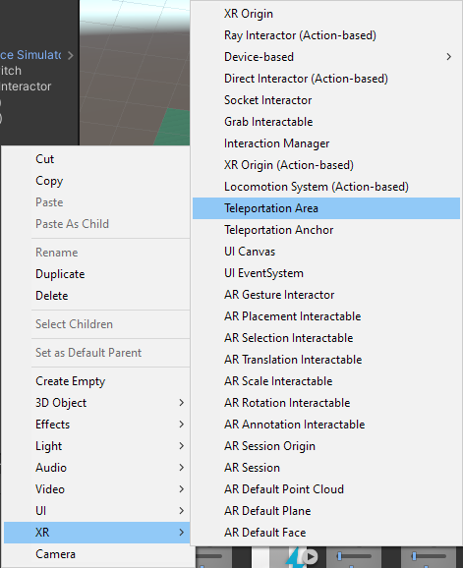
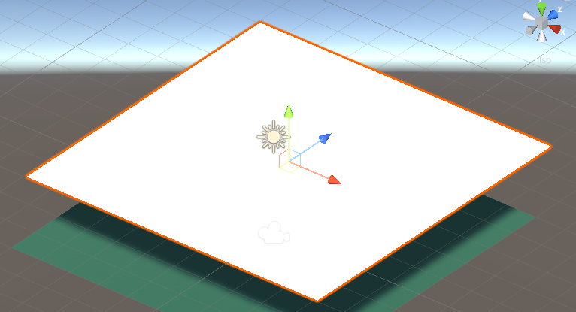
Teleportation
A Teleportation Area is a component that our Interactors (aka our Controllers) can detect and interact with to move our users.
To create one, right click in the Hierarchy and select XR > Teleportation Area.
A white plane will be added to your scene.

Slide 6
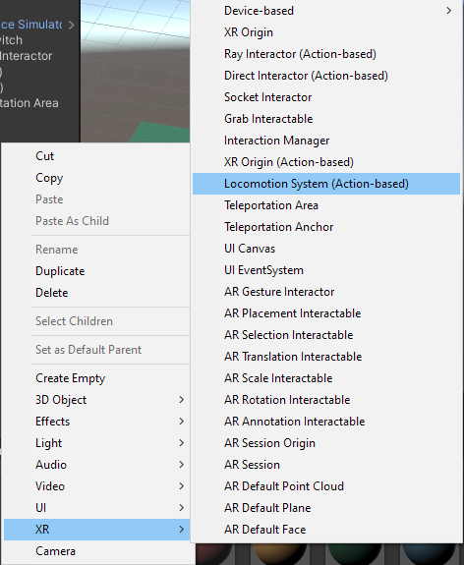
Teleportation
With the Teleportation Area added, replace the current ground plane with it instead.
Now, add a Locomotion System (Action-based) object into your scene.
Right click on the Hierarchy and select XR > Locomotion System (Action-based).
The Locomotion System will be responsible for moving our XR Origin through VR input (instead of physical movements).
It is a necessity in order to implement teleporting.

Slide 7
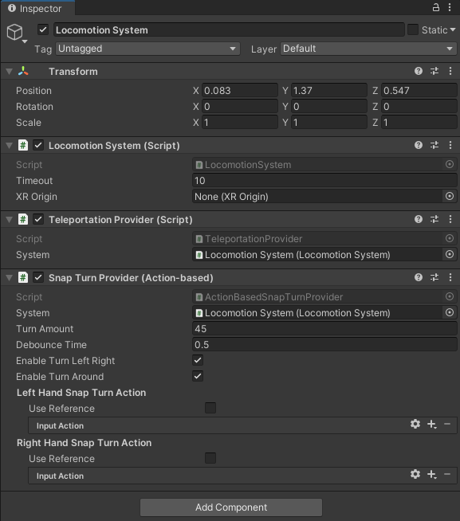
Teleportation
Look for the Locomotion System component in the object.
You will notice that the property “XR Origin” is currently ‘None’.
Drag and drop the XR Origin object you have in your scene into this property.
Once that is done, you will be able to teleport using your Ray Interactor and the grip button.

Slide 8
Demo Time!

Slide 9
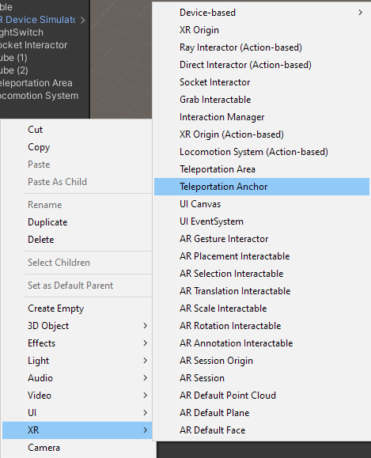
Teleportation
A Teleportation Anchor functions the same way as a Teleportation Area, but it has the additional feature of snapping the user to a specified transform.
To create a Teleportation Anchor, right click in the Hierarchy and select XR > Teleportation Anchor.

Slide 10
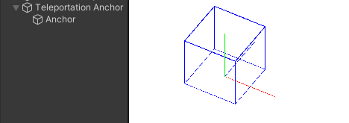
Teleportation
Once created, you will see a white plane added to your scene.
Expand the object in the Hierarchy.
You will see a child object named “Anchor”.
The Anchor object corresponds to the blue outlined cube that you see in your Scene view.
This cube will be used as a reference to where your user will stand and face after teleporting to the Teleportation Anchor.
The position and rotation of the cube can be manipulated by selecting the Anchor object and moving/rotating it the same way you would any other object.

Slide 11
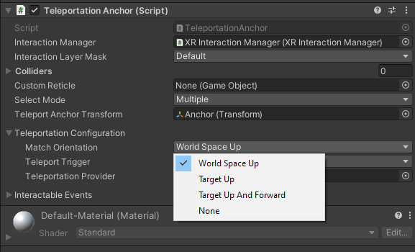
Teleportation
To set up the snapping feature, we must adjust the ‘Match Orientation’ setting in the Teleportation Anchor.
The options will affect the snapping in the following ways:
World Space Up
The upward direction of the user will match the world’s up direction.
Target Up
The upward direction of the user will match the cube’s up direction.
Target Up And Forward
None

Slide 12
Teleportation
To set up the snapping feature, we must adjust the ‘Match Orientation’ setting in the Teleportation Anchor.
The options will affect the snapping in the following ways:
World Space Up
Target Up
Target Up And Forward
The upward and forward direction of the user will match the cube’s up and forward direction.
None
The upward direction of the user will not match any direction.

Slide 13
Demo Time!

Slide 14
UI for VR
When creating user interfaces for a VR experience, we must keep in mind that we want to retain as much immersion as we can.
To do that, we typically avoid using non-diegetic UI.
Non-diegetic UI don’t exist in neither the space or the story of the virtual world.
We have previously looked at the different types of UI in game design, let’s go over them again as a refresher.

Slide 15
UI for VR
To recap:
 | Does it exist in the story of the virtual world?
Does it exist in the space of the virtual world? |  | Yes | No
 | Yes | Diegetic | Spatial
 | No | Meta | Non-Diegetic

Slide 16
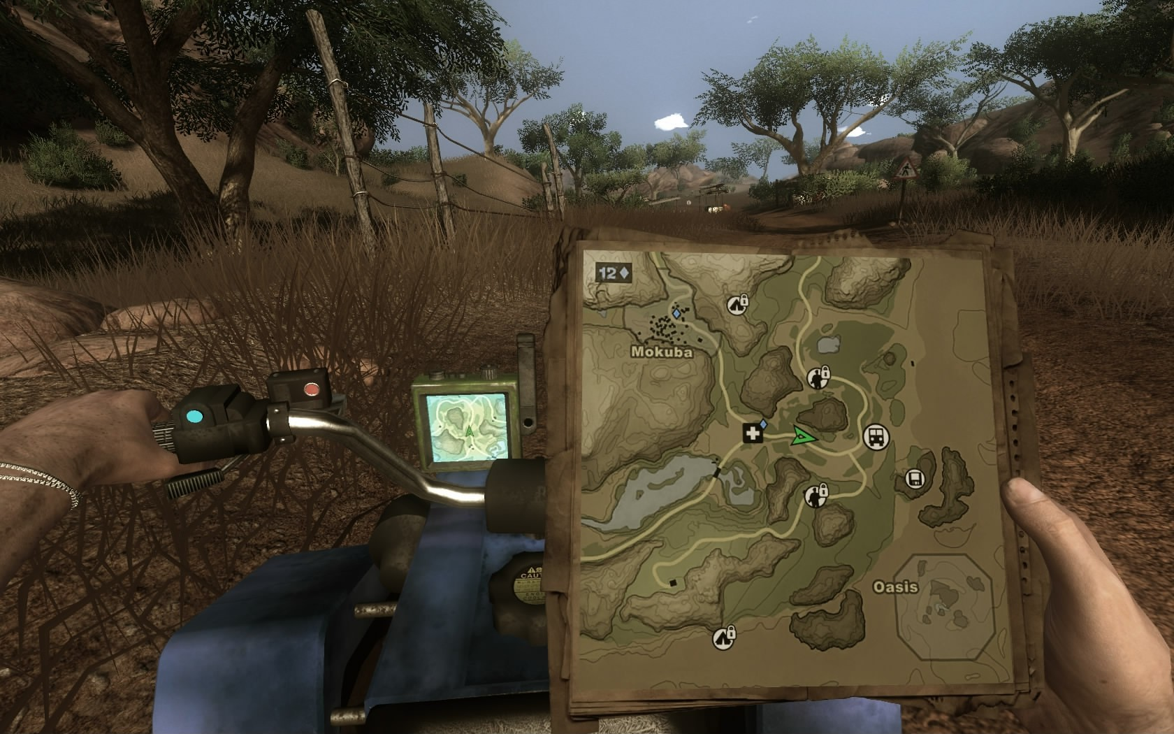
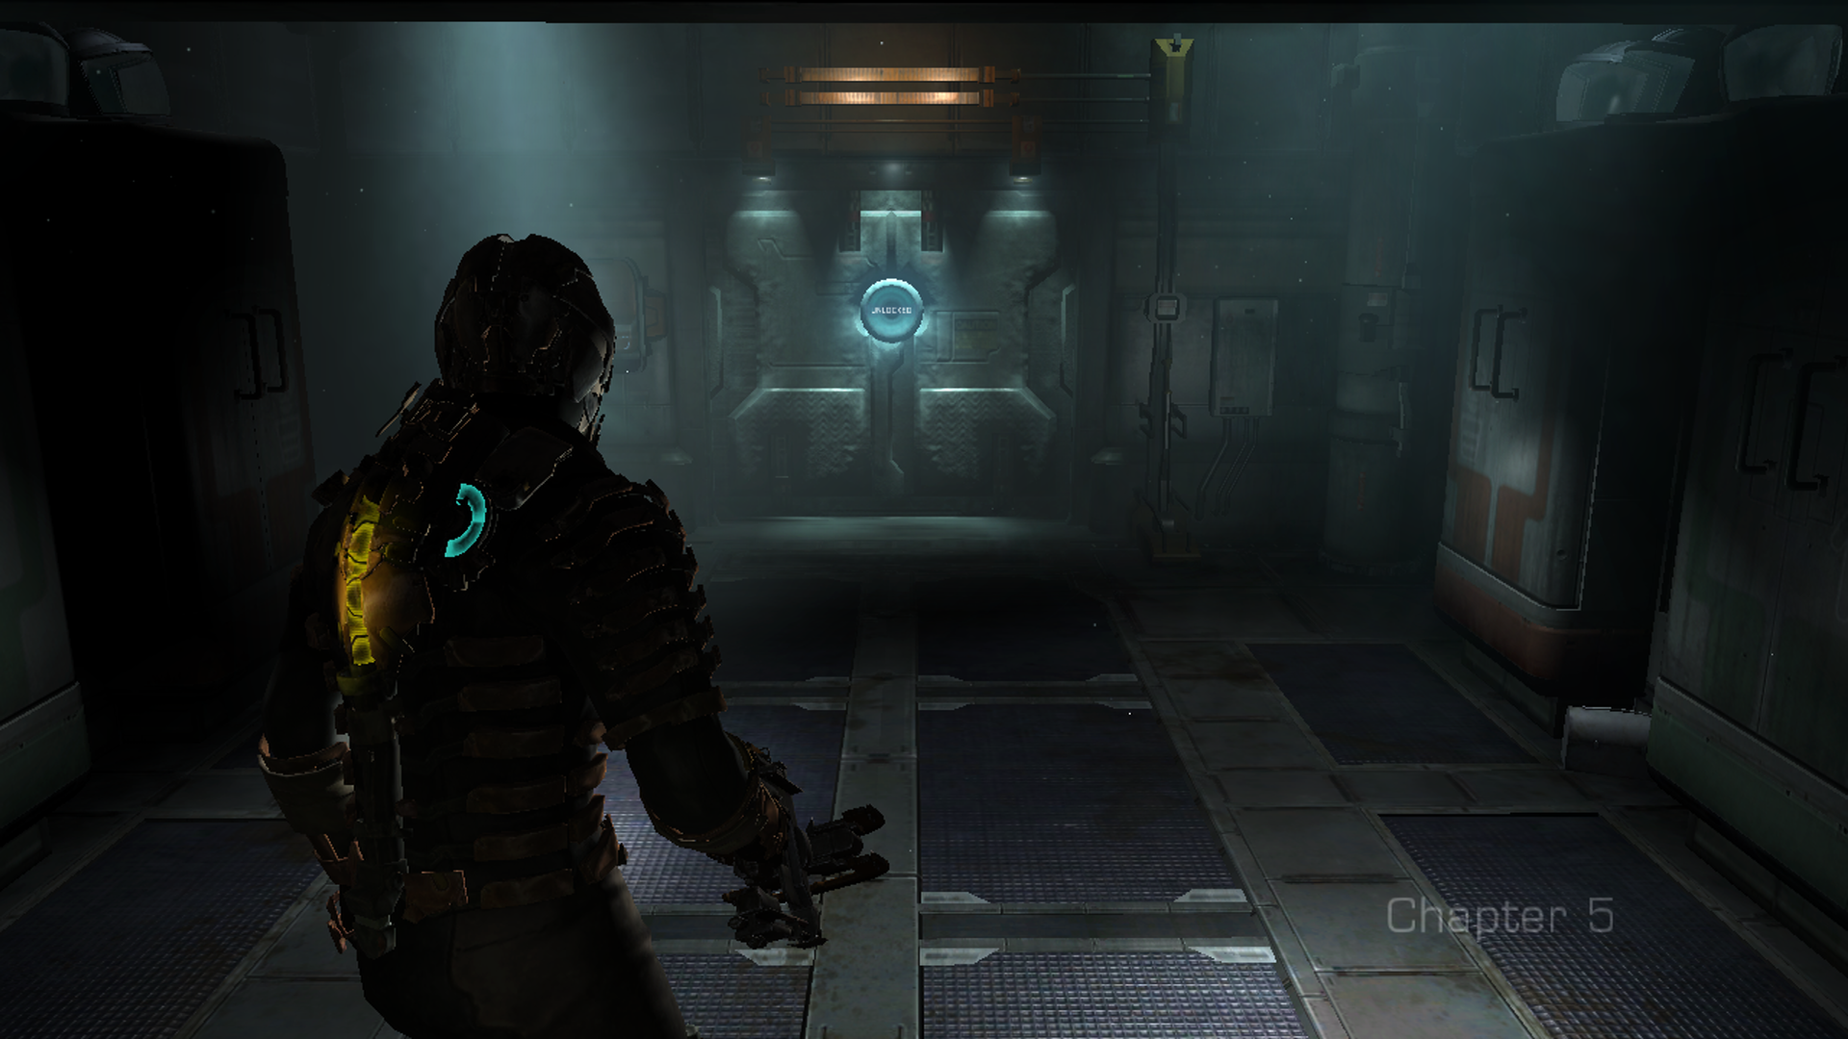
Types of UI
Diegetic
Exists in both the story and space of the virtual world.
The most immersive form of UI for virtual experiences.
However, can be quite hard to read or get information from.
E.g. bad camera angles, bad lighting, scale is too small, etc.

Slide 17
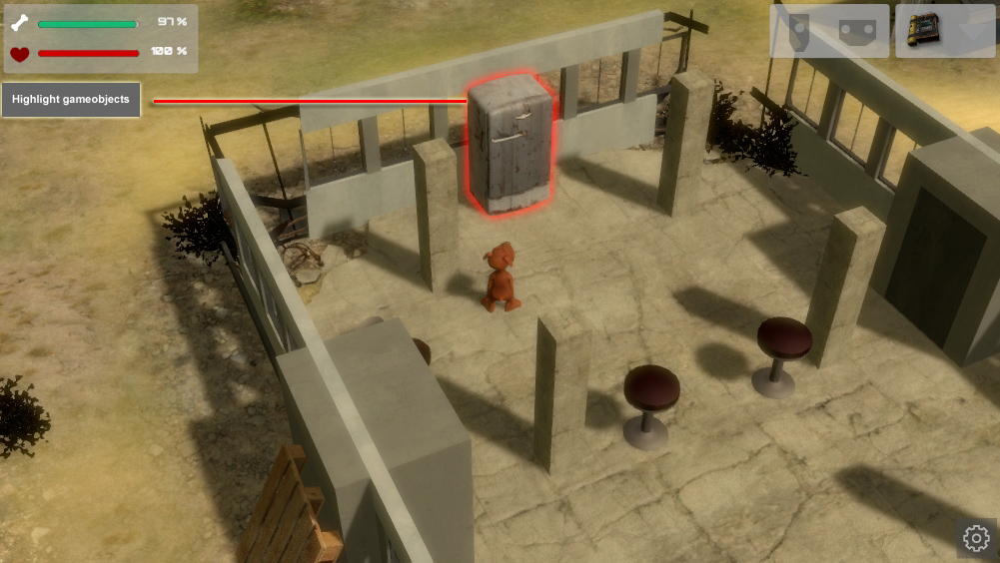
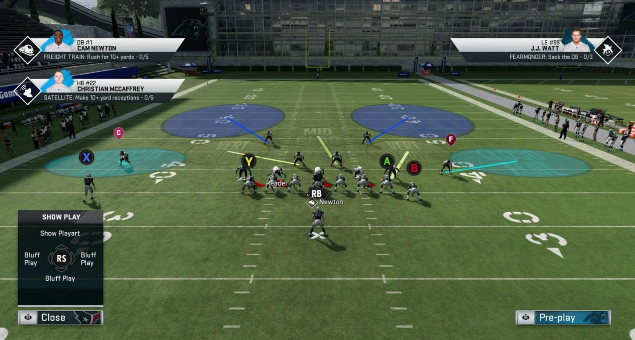
Types of UI
Spatial
Exists in the space of the virtual world, but not the story.
Guides users in selecting objects or looking at important landmarks.
Too many instance of Spatial UI may break the immersion of the user.
Because the avatars do not interact with the UI, the user becomes increasingly aware of the Fourth Wall.

Slide 18
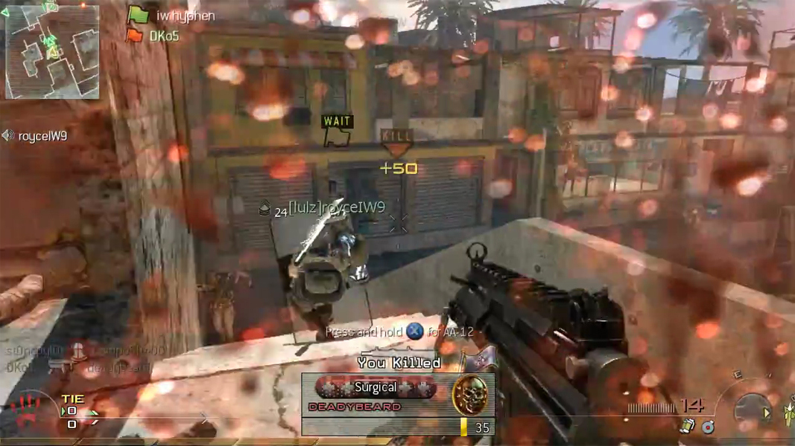
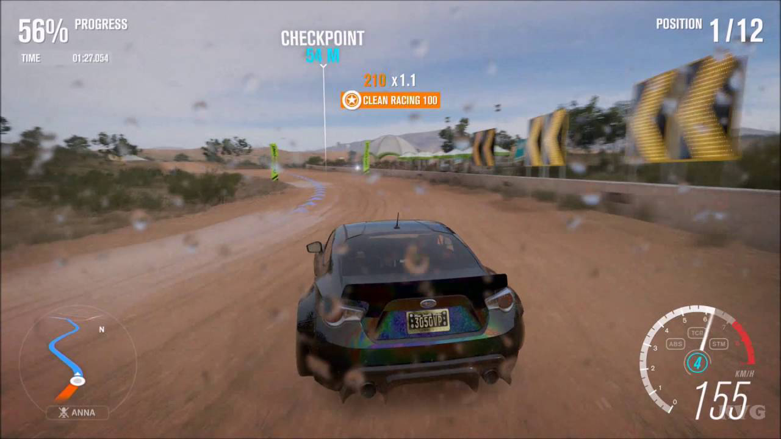
Types of UI
Meta
Exists in the story of the virtual world, but not the space.
Increases the immersion for users if done right.
Might irritate users if the UI component blocks the screen or disrupts gameplay for too long.
E.g. flashbang effects or blood effects lasting too long.

Slide 19
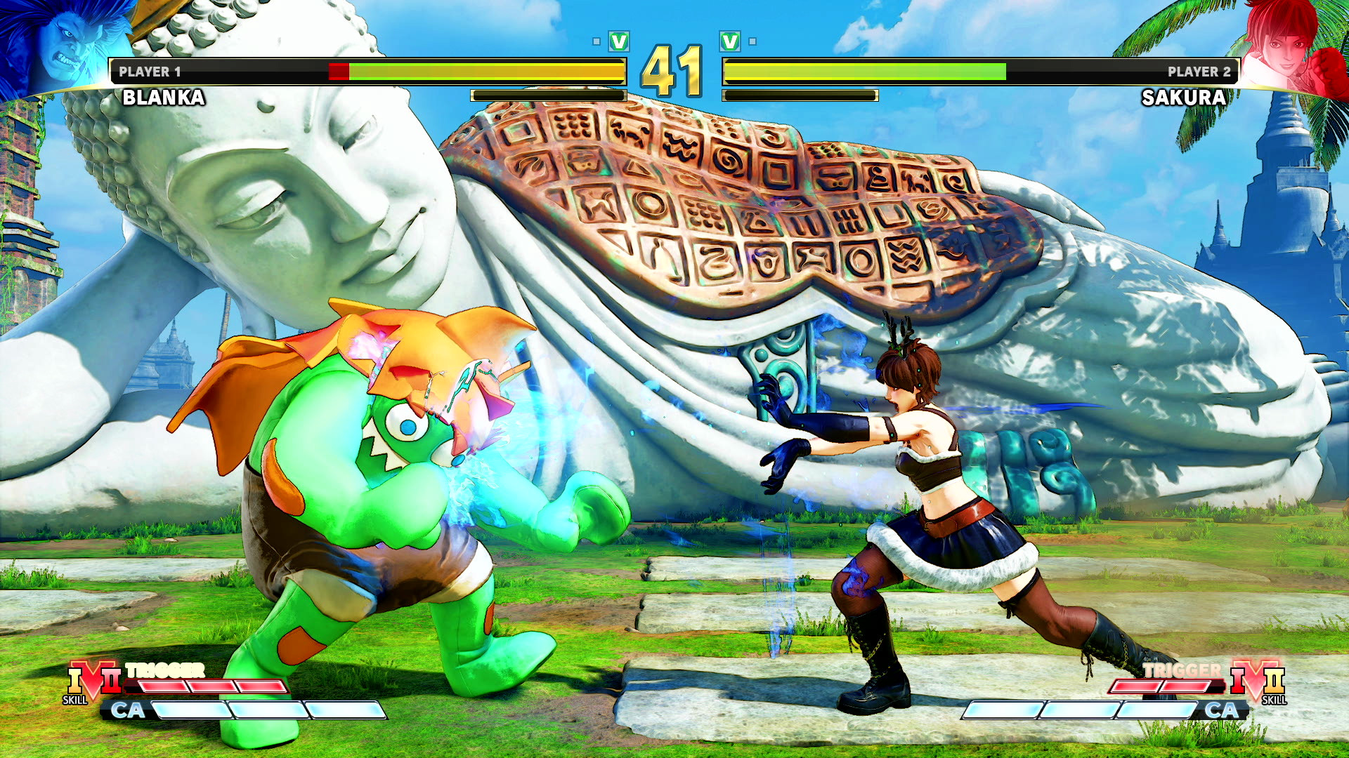
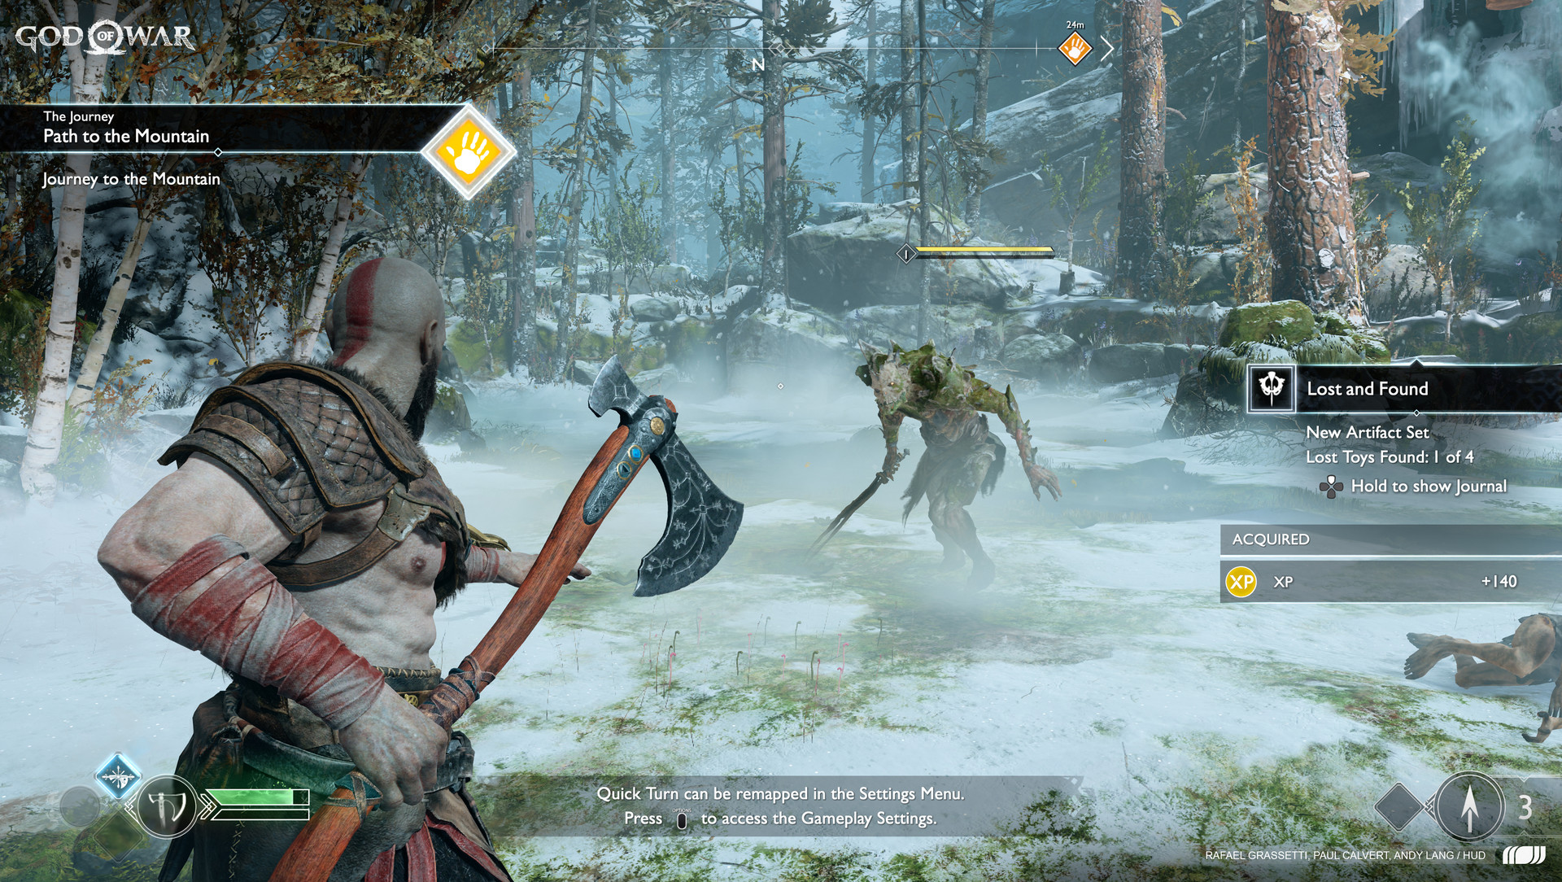
Types of UI
Non-Diegetic
Exists in neither the story or space of the virtual world.
Purely for displaying information to users.
The most immersion breaking form of UI we can use.
E.g. health/special bar on screen, timers, score counters, etc.

Slide 20
UI for VR
Last week, we created a form of spatial UI by having our grabbable objects highlight when a controller highlights over it.
This week, we will look at how we can create diegetic UI using the UI system of Unity and some other components from XRTK.
To start creating a piece of diegetic UI, right click in the Hierarchy and select XR > UI Canvas.

Slide 21
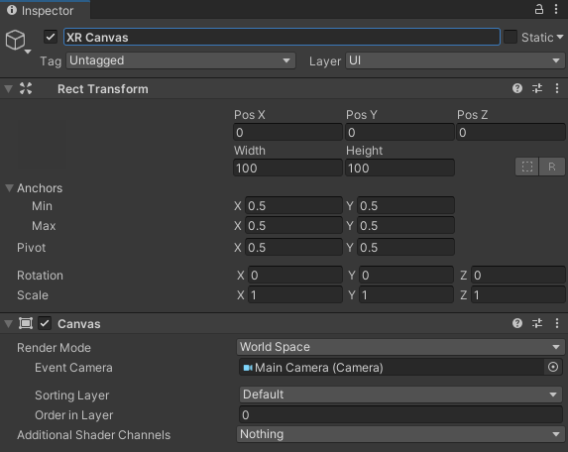
UI for VR
You will notice that the created Canvas will have its ‘Render Mode’ set as ‘World Space’, which is the correct setting for diegetic UI.
The size of the Canvas can then be changed to suit your use case by changing it’s Width and Height properties.
Try not to change the scale of the Canvas.
You will also notice an EventSystem object be created in your Hierarchy.

Slide 22
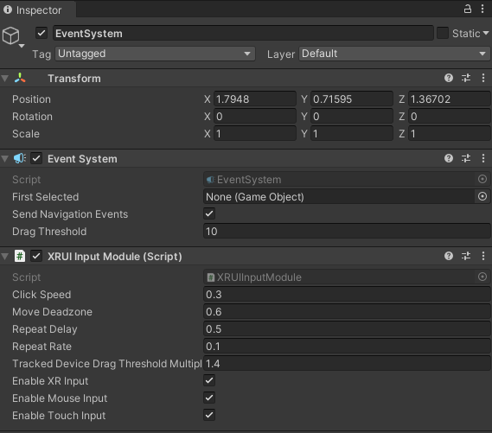
UI for VR
This EventSystem object is necessary for your VR input to be registered on UI objects (e.g. Buttons, InputFields, etc.)
Do note that you only need ONE of these in your scene.
It is not a case where each Canvas needs its own EventSystem.
You will also notice an ‘XRUI Input Module’ component on this object, which is also necessary for input to be registered.
The usual EventSystem that we have worked with does not have this component.

Slide 23
UI for VR
Now that both those objects are created, the Canvas can be populated with UI objects.
To add UI objects to the Canvas, right click on the Canvas object and select UI > *UI Object*.
The standard UI objects we have been using will work on this Canvas as well.
The user will be able to interact with the UI objects using the Ray Interactor and the trigger button (left click on simulator).

Slide 24
Demo Time!

Slide 25
Summary
With the use of Teleportation Areas and Anchors, we can create larger environments with more movement opportunities even when there are physical constraints in the real world.
The UI Canvas and EventSystem from the XR menu helps us quickly create diegetic UI that we can use with VR input.

Slide 26
Class Exercise (Individual)
Create a diegetic user registration form.
The form must at least collect the following info from your user:
Name
Email
Username
Password
The form must have at least a submit and a cancel button.
Take a screenshot of the form, paste it on Google Slide and provide a brief description of how users will access and use the form.
Google Slide: https://docs.google.com/presentation/d/1dPhQyBvGJAfZ3wHUnozPTOO5Tp6oGWvNz24XaSKD7Js/edit?usp=sharing
Contributes to CA2!

